Slide 1

IE 212: Computational Methods for Industrial Engineering
Lecture Notes #4:
Working with Variables
and
User Interfaces
Dr. J. David Porter
Winter 2013

Slide 2
Overview of this Module
Data types in VBA
Declaring variables
  Scope of variables
Using the MsgBox and InputBox functions
Conversion and string functions
Mathematical and trigonometric math functions

Slide 3
Data Types in VBA
Engineers primarily use computers to manipulate numerical data
  Integers and decimal values
However, engineers also deal with other forms of data
  Logical (true or false) and alphanumeric (names, dates, etc.)
VBA has two ways of dealing with data types
  VBA can automatically decide the data type to assign to a variable
    Requires less effort (NOT RECOMMENDED)
  The user can explicitly specify the variable type
    Translates into procedures that run more efficiently and programs that are easier to debug
    In this course, you must always declare your variables EXPLICITLY

Slide 4
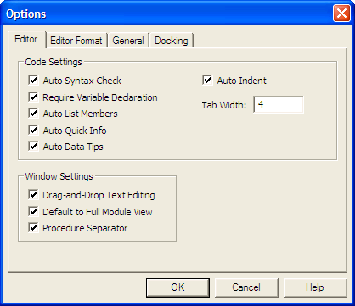
Data Types in VBA (cont.)
Forcing explicit variable declaration
  In the VBE, select Tools > Options…
  Select the tab Editor (if it is not already selected)
  Add a checkmark to the option “Require variable declaration”
Close and re-open Excel

Slide 5
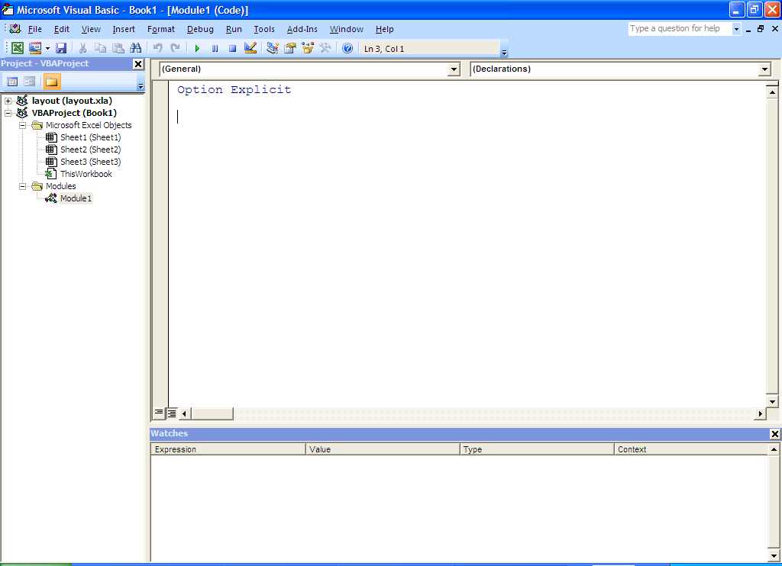
Data Types in VBA (cont.)
The action just executed will automatically add a special line of code at the beginning of all VBA procedures
  Option Explicit

Slide 6
Data Types in VBA (cont.)
A data type categorizes the values that can be assigned to a variable
  There are several different data types available in VBA
The following VBA data types are used most often
  Integer
    Long
  Double
    Single
  String
  Boolean
  Variant
  Range
  Worksheets

Slide 7
Data Types in VBA (cont.)
The justification for the many different data types is the trade off among
  Calculation requirements
    A variable is needed to store the total number of seconds in a 24-hr period. What data type should be used?
    Variable type definition should be planned carefully so that program execution errors are avoided
  Memory requirements
    Variable data types that use more bytes (1 byte = 8 bits) require more computer memory
  Processing time requirements
    VBA processes double-precision numbers more efficiently than single-precision numbers

Slide 8
Variable Declaration in VBA
The statement Dim is used in VBA to declare a variable
  Dim variable As DataType
  Undeclared variables are of type Variant
Conditions when naming variables
  Must start with a letter
  Must contain only letters, numbers or the underscore (i.e., _) character
  Name must not exceed 255 characters
  Must not use special characters (e.g., !, ?, &) or blank spaces
  Must not use keywords (e.g., Set) as variable names
Pick a style to name your variables and be consistent

Slide 9
Variable Declaration in VBA
In Excel VBA, the type of each variable must be set individually
For example, assume that you would like to declare variables var1 and var2 as type Integer. Which statement should you use?
  Dim var1 As Integer, var2 As Integer
  Dim var1, var2 As Integer
  Both a) and b) will work

Slide 10
Variable Declaration in VBA (cont.)
In VBA, you can also define constant variables
  Use the keyword Const to declare a constant variable
    Const var_Name = Value
    Const pi = 3.141593
  One a constant is declared, it cannot be modified or assigned a new value in the code

Slide 11
Integer and Double Data Types
Numerical values can be represented with both the Integer and Double data types
Type Integer
  Non-decimal numbers that range in value from -32,768 to 32,767
  Used for simple numerical values, counting in loops, and enumerating arrays
Type Double
  Negative range → -1.79769E308 to -4.94065E-324
  Positive range → 4.94065E-324 to 1.79769E308
  Used for any data or calculations
Notes:
(there are many other numerical data types such as long and single which we will not review in detail here; more information can be found on these other data types using the Microsoft Help tool).

Slide 12
String Data Type
A string is a segment of text and may include
  Upper and lower-case letters
  Punctuation marks
  Numbers
Numbers assigned to a variable of type String cannot be used in calculations
  They will be viewed as text
Strings are commonly used to name objects, label objects, and label data in spreadsheets

Slide 13
Boolean Data Type
A Boolean is a variable whose value is either True or False
Boolean variables will be used often in
  Logic statements,
  If…Then statements, and
  Loops

Slide 14
Range Data Type
A variable of type Range inherits all the properties and methods of the Range object
The Set declaration statement must be used to initialize the value of a variable of type Range
  For example, to set the variable MyRange equal to cell A1 we would type the following
    Dim MyRange As Range
    .
    .
    .
    Set MyRange = Range(“A1”)

Slide 15
Range Data Type (cont.)
Variables of type Range will be used often to increase the efficiency of VBA code
  A variable of type Range can be used to define a StartCell
    The value of this range variable is set at the beginning of the code and then referenced throughout the remainder of the code
Variable of type Range can also be used to make VBA code more dynamic
  e.g., use an Input Box to capture where the user wants to start a table

Slide 16
Worksheet Data Type
The Worksheet data type defines a Worksheets object
A variable of type Worksheet inherits all the properties and methods of the Worksheets object
  This object can be used when creating loops and/or functions to perform repeated methods or set repeated properties to multiple worksheets

Slide 17
Scope of Variables in VBA
It is very important to understand the scope of each variable that is declared
An important program design step is to ask yourself the following questions
  Will the variable be used only in this sub procedure?
  Will the variable be used only in this function procedure?, or
  Will the variable be used in several different procedures?
There are two VBA keywords used to set the scope of a variable
  Private
  Public

Slide 18
Private Variables
A variable can be of scope Private on two levels
  Module level
    Variable can be used in any procedure in the module, but only in the particular module in which it was declared
    Variable is created when the module starts, and then stays in existence until the module terminates
    Use keyword Dim or Private in the variable declaration statement before the 1st Sub procedure in the module
  Sub procedure level
    Only used in the particular sub procedure in which it was declared
    Variable is created when the procedure starts, and then destroyed when the procedure terminates
    Use keyword Dim in the variable declaration statement

Slide 19
Procedure Level vs. Module Level
Procedure level Private declaration
  Sub Sub1()
  Dim i As Integer
  .....
  End Sub
  ----------------------------------
  Sub Sub2()
  Dim i As Integer
  ....
  End Sub
Module level Private declaration
  Dim (or Private) i As Integer
  -------------------------
  Sub Sub1()
  .......
  End Sub
  ------------------------
  Sub Sub2()
  ........
  End Sub

Slide 20
Public Variables
The Public declaration statement is used to declare the scope of a variable as public
  The keyword Public can only be used at the module level
    Public i As Integer
A variable with scope Public can be used in any sub procedure in any module
  Also referred to as a Workbook or global variable
Notes:
We recommend using public variables in your programs. This will prevent you from finding errors when calling different sub procedures or functions

Slide 21
Keeping Track of Variable Values
There are two main ways to keep track of variable values while running (or debugging) a VBA program
  Use the Watch Window
    Click on View > Watch Window from the menu
    Select any variable from the Code Window and drag it to the Watch Window
  Hold your cursor over a variable name in the Code Window to see a small display of its value

Slide 22
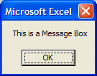
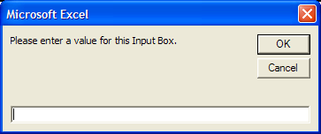
Variables in User Interface
Message Boxes allow you to display messages to the user in a small dialog box
Input Boxes allow you to prompt the user to enter a value in a small dialog box

Slide 23
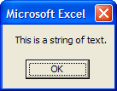
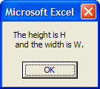
MsgBox Function
The following can be printed with the MsgBox function
  Text
  Variable values
  You can concatenate text and variable values with the & character
  MsgBox “This is a string of text.”
  MsgBox "The height is " & h & vbCrLf & _
  " and the width is " & w & "."

Slide 24
MsgBox Function (cont.)
Button types and response types can be specified as part of the MsgBox function to make it more user-friendly
  MsgBox (prompt, [buttons], [title], [helpfile, context])
MsgBox function arguments
  The prompt is either text or a variable (or concatenation of both) which will be displayed in the dialog box
  The title argument allows you to enter a title for the dialog box
  The helpfile and context arguments allow you to give the user help options
Notes:
Only the prompt argument is required, all other arguments are optional.
We usually ignore the helpfile and context arguments

Slide 25
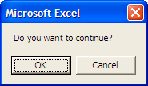
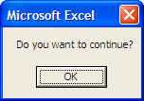
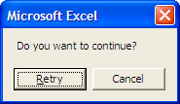
MsgBox Function (cont.)
The buttons argument takes a VB Constant value to determine the number and style of buttons available to the user
  vbOKOnly
    Displays an OK button only
  vbOKCancel
    Displays OK and Cancel buttons
  vbYesNoCancel
    Displays Yes, No, and Cancel buttons
  vbYesNo
    Displays Yes and No buttons
Notes:
We will see examples of using this response value in Ch 15

Slide 26
MsgBox Function (cont.)
If the VBA program intends to capture which button is pressed by the user, then the arguments of the MsgBox function must be enclosed in parentheses
  MsgBox function structure to display data only
  MsgBox function structure to capture a user’s response (i.e., button pressed)
  MsgBox "This is a message box to display information", _
  vbCritical, "Please respond"
  response = MsgBox (“Do you want to continue?", _
  vbYesNo, “User Input Required)
Notes:
We will see examples of using this response value in Ch 15

Slide 27
MsgBox Function (cont.)
The user’s response can be captured and assigned to a VBA variable of type integer
  vbOK or 1
    If response was OK
  vbCancel or 2
    If response was Cancel
  vbAbort or 3
    If response was Abort
  vbRetry or 4
    If response was Retry
  vbIgnore or 5
    If response was Ignore
  vbYes or 6
    If response was Yes
  vbNo or 7
    If response was No
Notes:
We will see examples of using this response value in Ch 15

Slide 28
InputBox Function
The InputBox function must always be assigned to a variable
  The InputBox function returns a String containing the contents of the text box
The InputBox function general form is:
  InputBox (prompt, [title], [default], [xpos], [ypos], [helpfile, context])
InputBox function arguments
  The prompt and title arguments of the InputBox function are the same as those of the MsgBox function
  The default argument sets the default value to display in the InputBox
  The xpos and ypos arguments set the position of the Input Box relative to the left and top edges of the screen
  helpfile and context arguments (same as the MsgBox function)

Slide 29
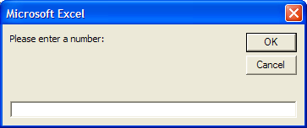
InputBox Function (cont.)
For example, you may prompt the user to enter a number and store the user value in the variable UserNumber
  UserNumber = InputBox (prompt, [title], [default], [xpos], [ypos], [helpfile, context])

